Slide 1

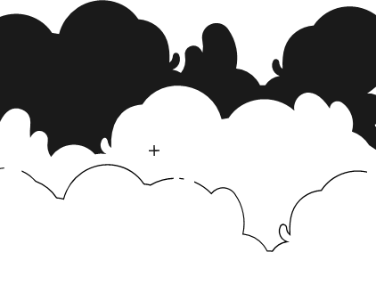
PRINCIPLES OF ARTIFICIAL INTELLIGENCE
SOF106
DR SHAMINI RAJA KUMARAN
HILL CLIMBING
SIMULATED ANNEALING
www.website.com
PREPARED BY DR SHAMINI

Slide 2
XMUM VISION
Xiamen University Malaysia aspires to become a university with a distinct global outlook, featuring first-class teaching and research, and embracing cultural diversity.
XMUM MISSION
To nurture young talents with dignity and wisdom, turning them into fine citizens of the region who will contribute to the prosperity of the people and social progress of Malaysia, China and Southeast Asia.To nurture young talents with dignity and wisdom, turning them into fine citizens of the region who will contribute to the prosperity of the people and social progress of Malaysia, China and Southeast Asia.

Slide 3
SIMULATED ANNEALING
RE-CAP HILL CLIMBING + SIMULATED ANNEALING

Slide 4
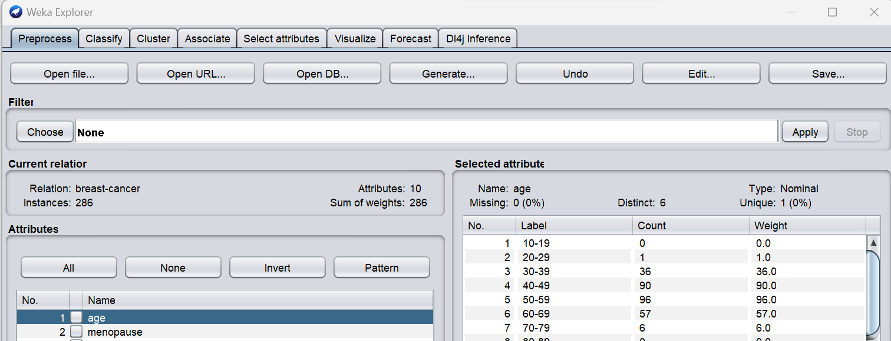
SIMULATED ANNEALING -CLASSIFY
Open the Weka GUI Chooser.
Click the “Explorer” button to launch the Explorer.
Open the breast-cancer.arff dataset.
Click the “classify” tab to access the CLASSIFICATION.

Slide 5
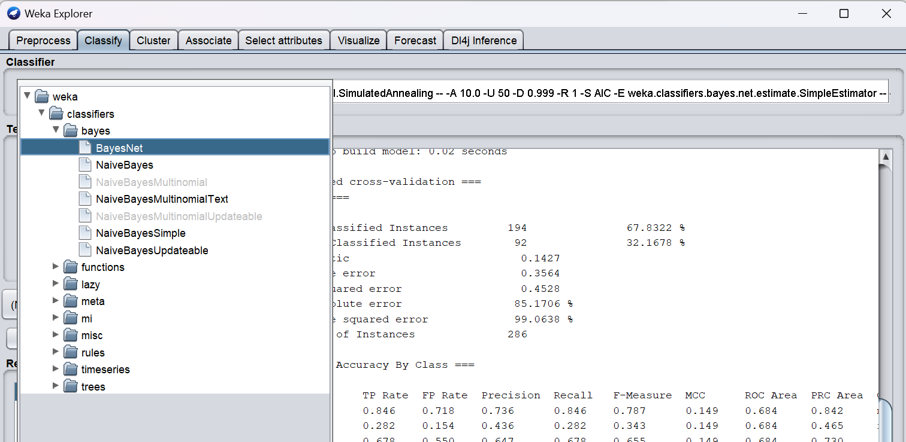
SIMULATED ANNEALING -CLASSIFY
Choose Classify.
Choose Bayes Net
Click BayesNet - searchAlgorithm - SimulatedAnnealing

Slide 6
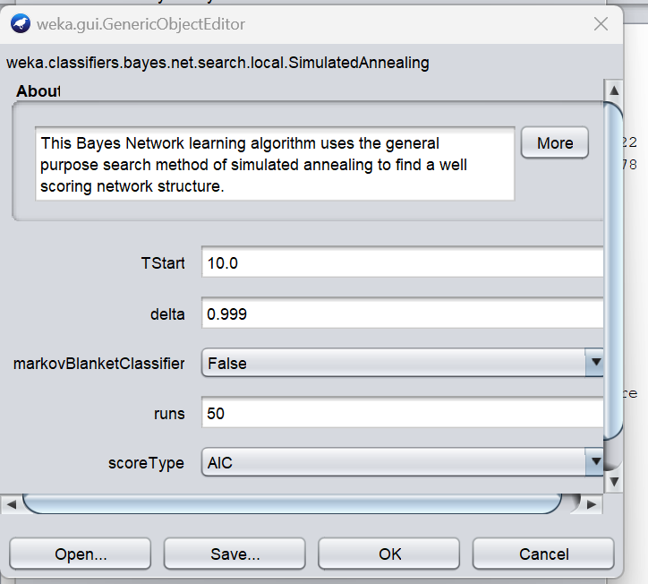
SIMULATED ANNEALING -CLASSIFY
Let’s Try to Understand - Parameter Setting
tstart (Initial Temperature): tstart represents the initial temperature of the annealing process.
delta: refers to the change in the objective function or energy between the current solution and a neighboring solution.
Markovblanket: represents a set of variables that, when known, make the target variable (the node in question) conditionally independent of all other variables in the network.
runs: iterations
scoreType: represents the scoring metric
Focus here on AIC : AIC (Akaike Information Criterion):
AIC is a measure of the goodness of fit of a statistical model. It balances model accuracy and complexity.
Lower AIC values indicate better models with a good balance between fit and complexity.

Slide 7
THANK YOU
www.website.com
PREPARED BY DR SHAMINI

